Slide 1


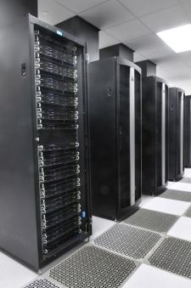
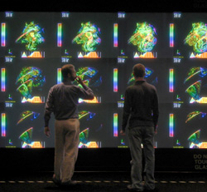
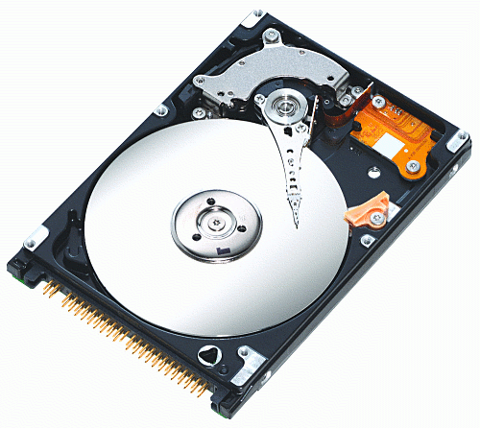
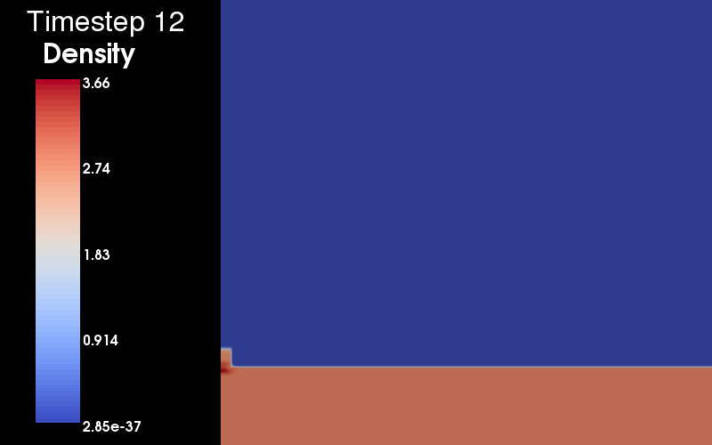
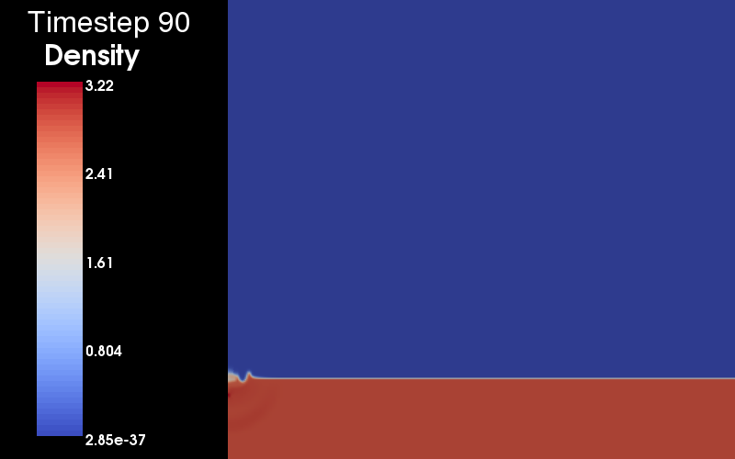
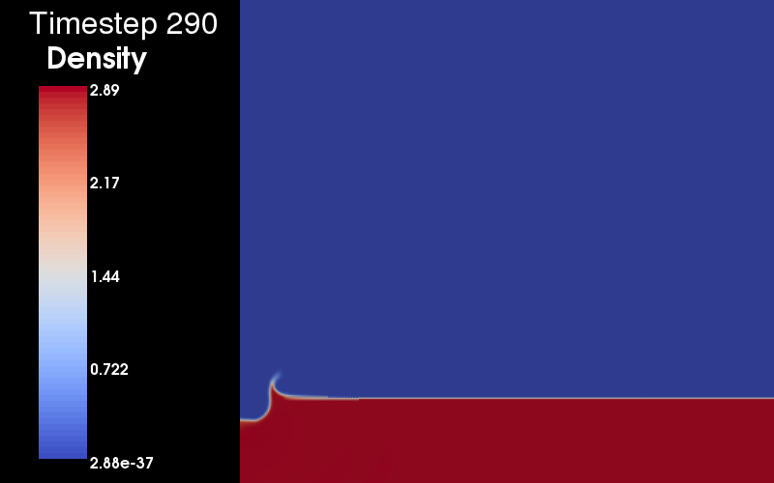
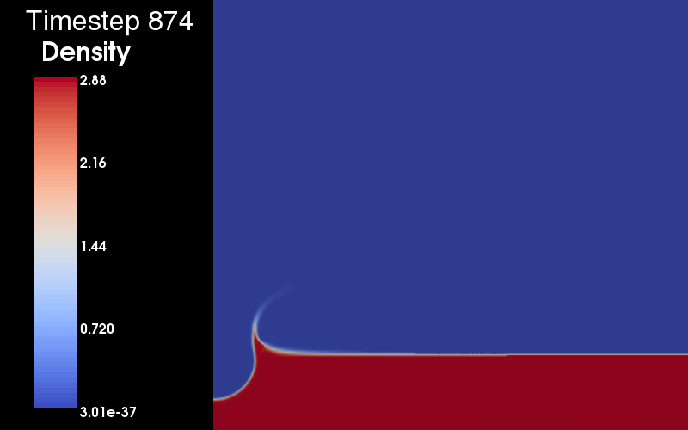
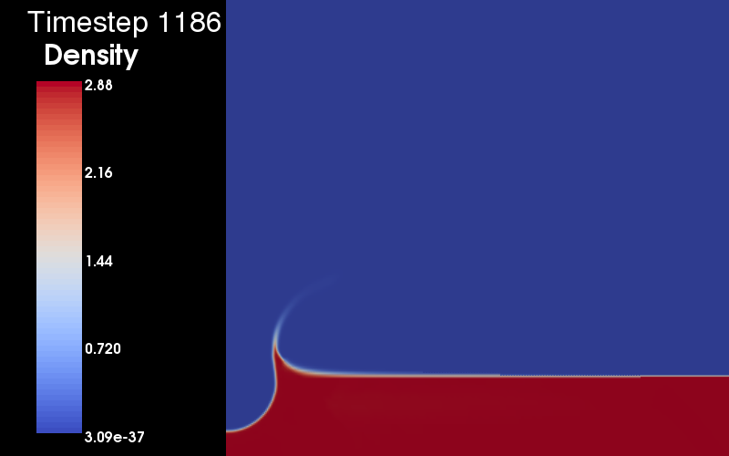
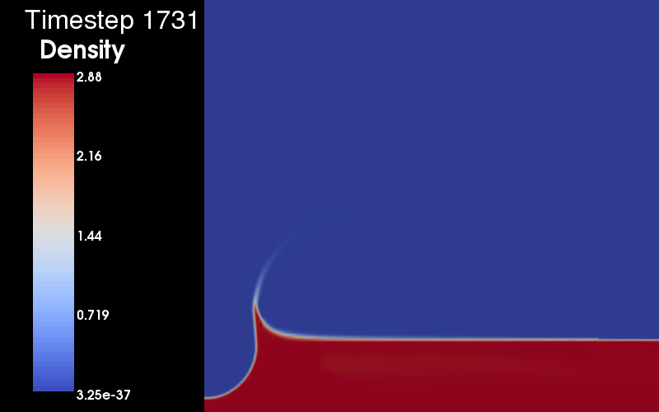
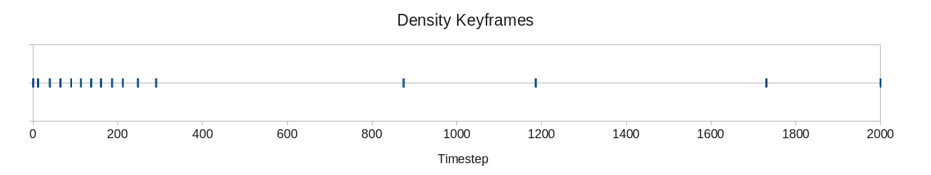
Automatic Data Selection for In Situ Analysis
Science Problem: Cognitive capacity (human/scientist understanding), storage and I/O have not kept up with our capacity to generate massive amounts physics-based simulation data. Data must be reduced, but which data do we keep or look at?
Technical Solution: Apply automatic data selection operations using various metrics and criteria to emulate the exploration during physics simulations (in situ) and make the data bandwidth use more “information dense.” Physics simulations are reduced to a representative set based on the selected metric that is used.
Science Impact: Scientist and analyst time is more efficient and bandwidth (cognitive, storage and I/O) is “richer,” as more scientifically-relevant simulation information is packed into it.
Woodring, Myers, Nouanesengsy, Wendelberger, Patchett, Fasel, Ahrens
dynamic computational
raw data
detectors
events
flow control
(lightweight)
triggers
data
products
(heavyweight)
discovery

