Slide 1
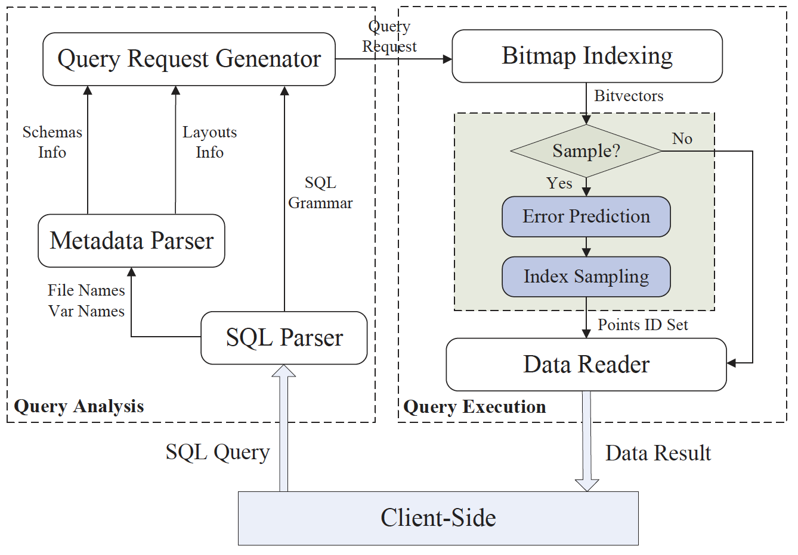
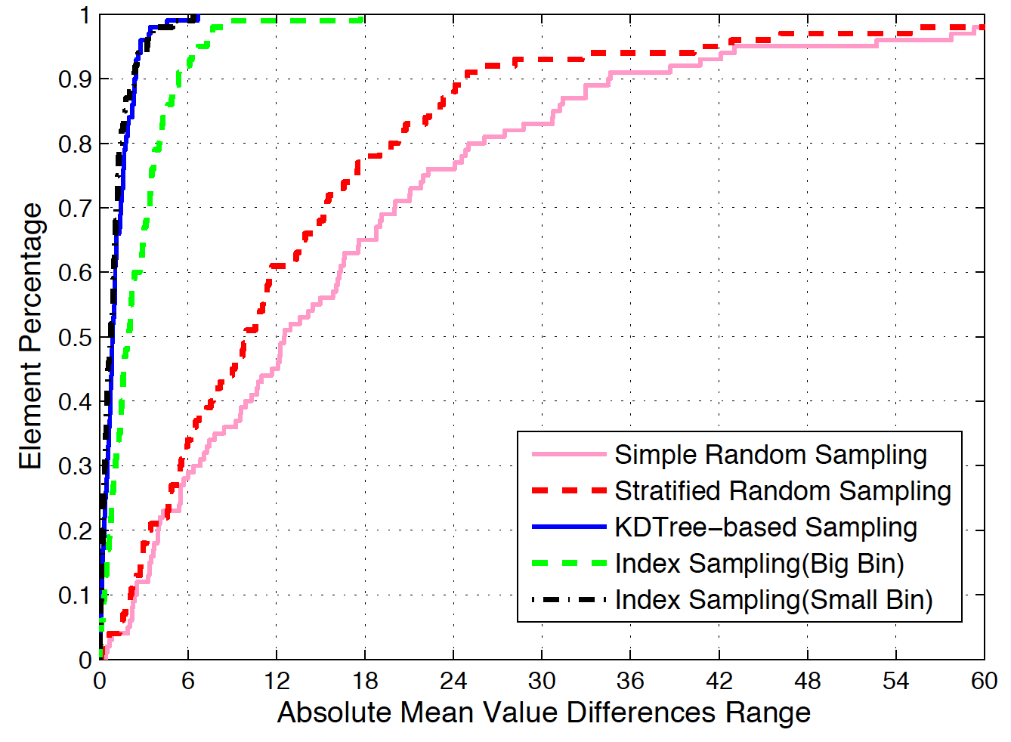
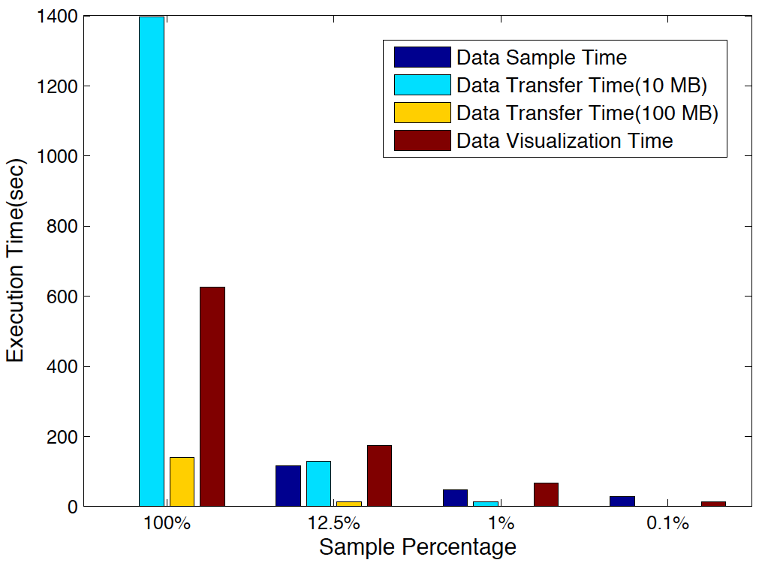
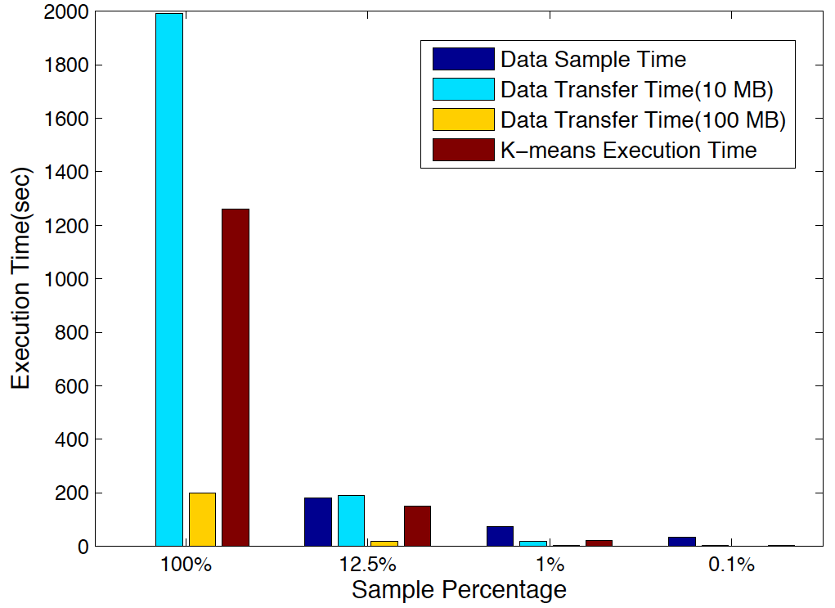
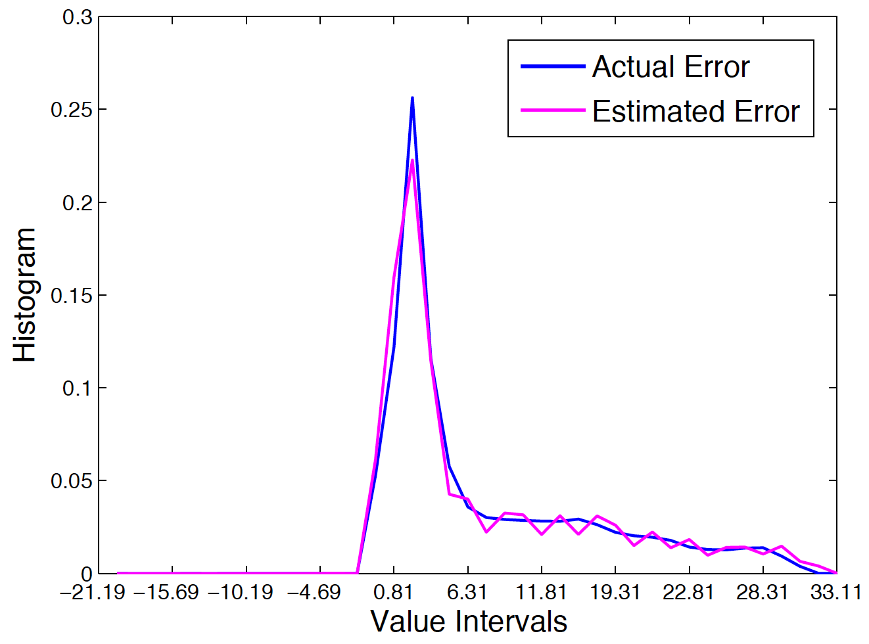
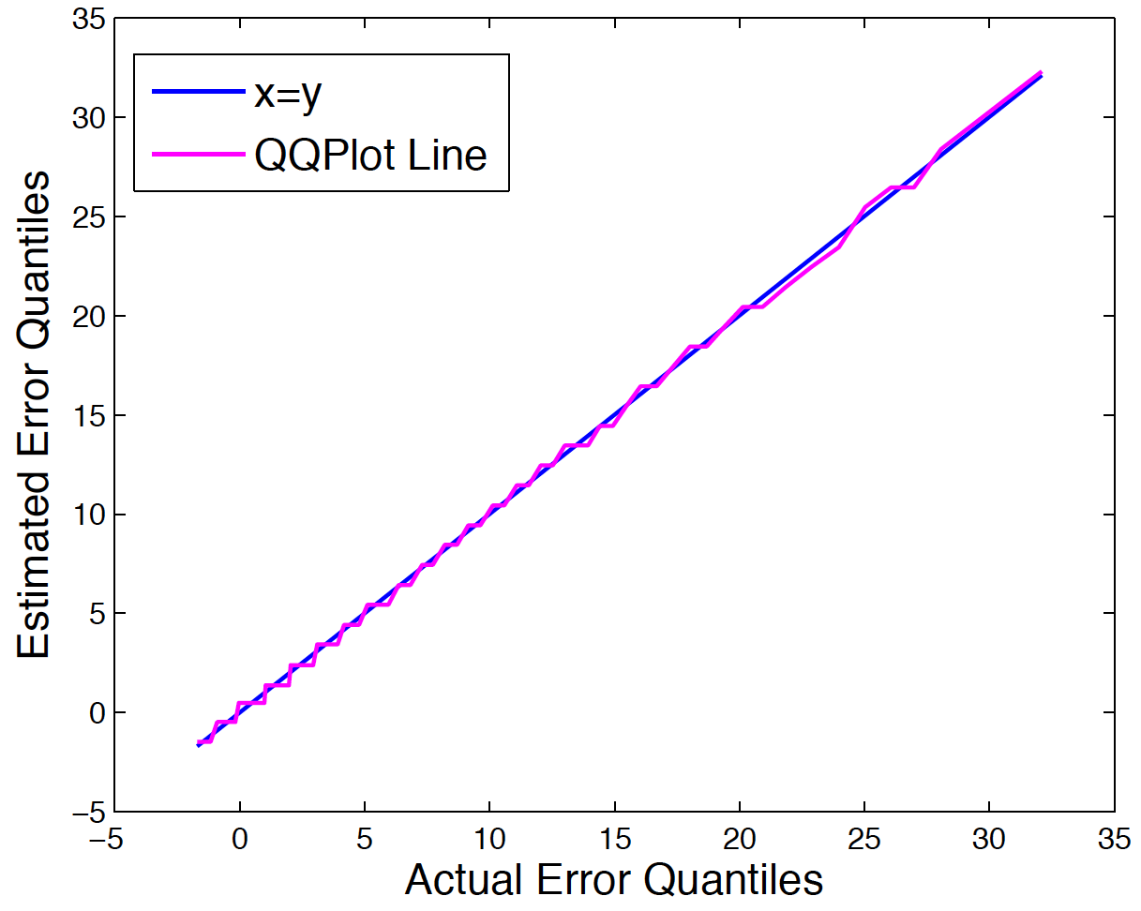
Combining Statistics, Sampling, and Indexing to Quantitatively Scale Massive Scientific Data
Science Problem: Climate and cosmological analysis and exploration via queries on their massive data sets may still result in a massive amount of data for the scientist to comb through and/or transfer.
Technical Solution: Combine bitmap indexing with stratified random sampling (stratified by bins, random within bins) with precalculated errors to quickly and quantitatively scale data.
Science Impact: Climate and cosmological scientists are able to interactively and automatically scale data queries down to smaller samples with automatic error estimates, accelerating their scientific analysis workflow.
Su, Agrawal, Woodring, Myers, Wendelberger, and Ahrens. “Taming Massive Distributed Datasets: Data Sampling Using Bitmap Indices.” To appear in HPDC 2013.

