Slide 1
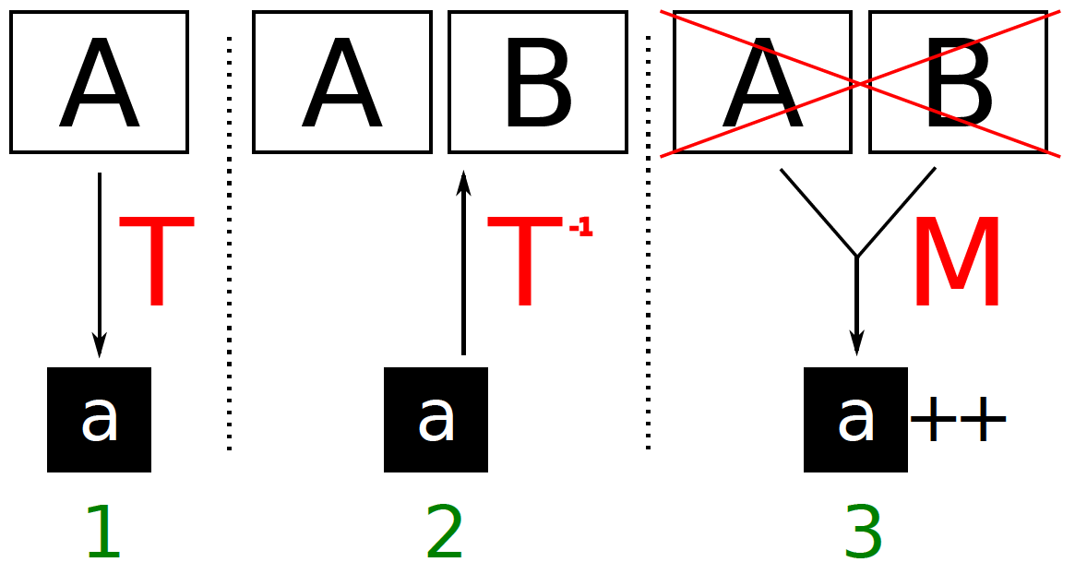
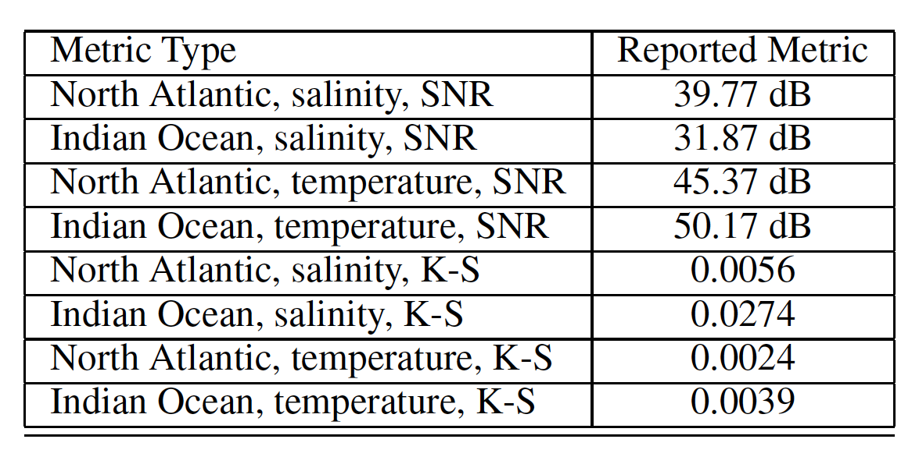
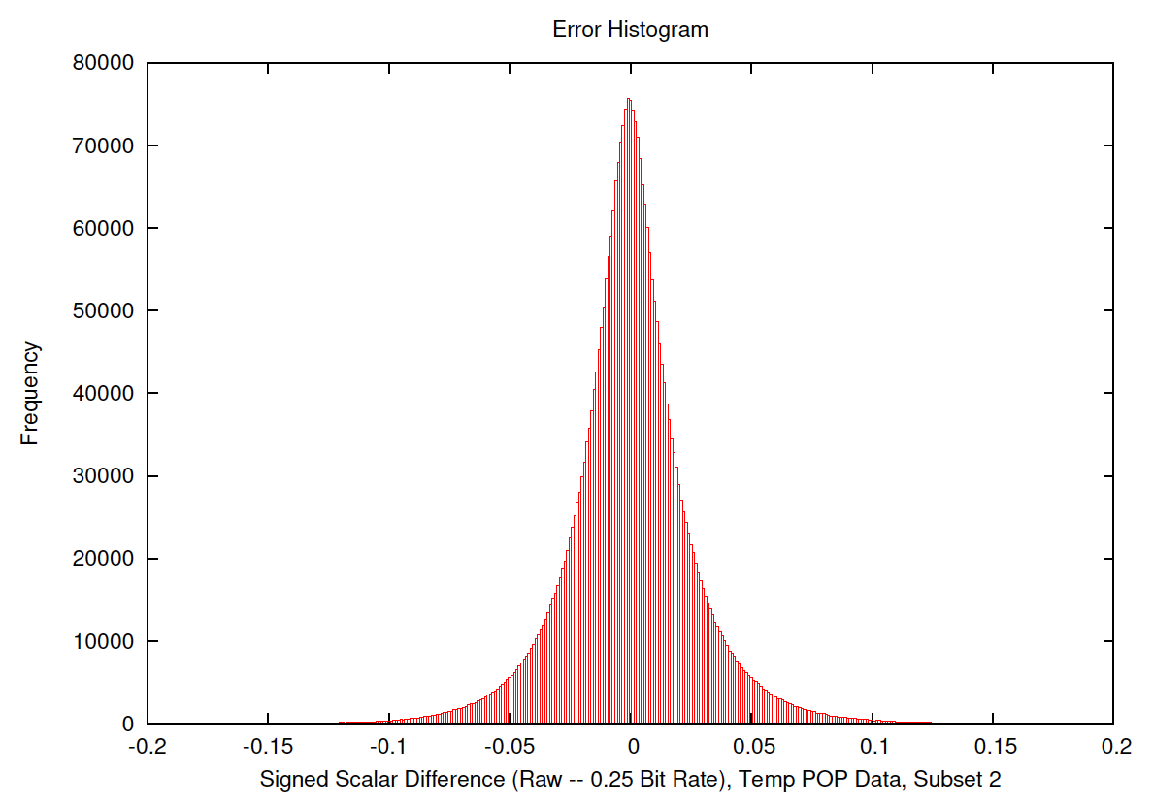
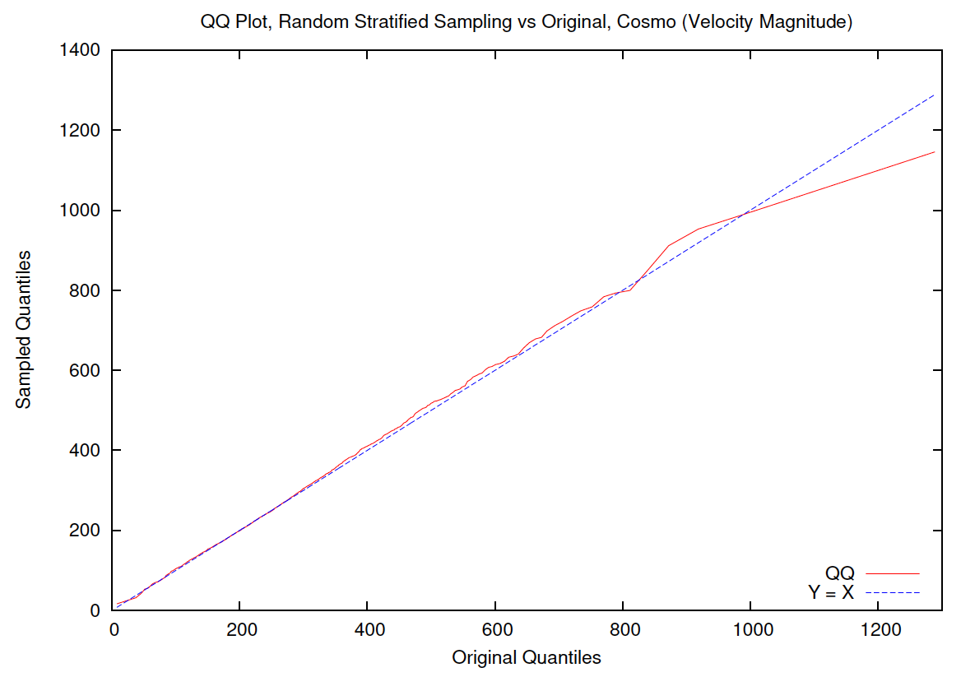
Metrics and Workflow for Quantifying the Quality of Reduction Transformations on Large-Scale, Scientific Scalar Data
Science Problem: Storage and I/O have not kept up with climate and cosmological simulation capacity to generate data. Data must be reduced, but what has been lost in the process of reduction?
Technical Solution: After every reducing transformation (T), assess and record the residuals/errors via compact measures (M) comparing reduced (a) to “original” data (A) by reconstructed data (B).
Science Impact: Measuring the data uncertainty via a quantitative quality provenance shows that climate and cosmological scientists are able to use reduced data for scientific analysis.
Woodring, Shafii, Biswas, Myers, Wendelberger, Hamann, and Shen. “Metrics and Workflow for Quantifying the Quality of Reduction Transformations on Large-Scale, Scientific Scalar Data.” Submitted to LDAV 2013.

